Slide 1
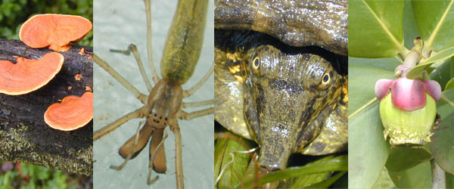
GENERAL BIOLOGY fdn 1203
Dr. Theja Abayarathna
Department of Biology
Faculty of Applied Sciences
Rajarata University of Sri Lanka

Slide 2
Pollution

Slide 3
Pollution and Control
Pollution is an undesirable and excessive addition of substances to water, air and land that adversely alter the natural quality of the environment.
The agent that pollute is called pollutant.

Slide 4
Air pollution
The occurrence of many foreign materials or gases in the atmosphere may be harmful to man, animals and vegetation
Mainly they are in 2 categories
1. Gaseous
Remain in gaseous state in normal temperature and pressure.

Slide 5
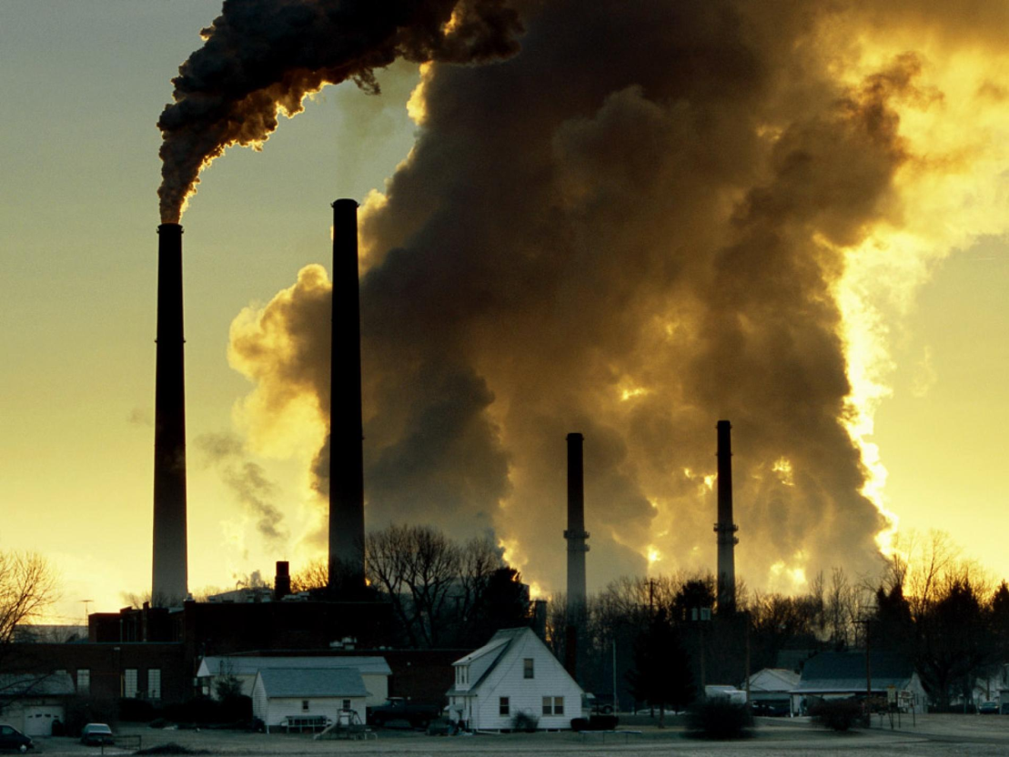
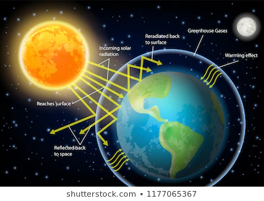

Slide 6
Examples
1.CO2
Not harmful gas by itself.
It is released to the atm. by burning of fossil fuel.
It forms a blanket around the earth.
It stops the heat from escaping and causes temperature to rise called “green house effect”.

Slide 7
2. Oxides of sulphur
Both SO2 and SO3 are harmful.
They react with water and form Sulphuric acid which cause acid rains when precipitate.
It is harmful to plants, fishes ect.

Slide 8
3. Oxides of Nitrogen
They form dilute solution of nitric acid cause acid rains.
It is harmful for human.

Slide 9
4. CO
Colorless, odorless, nonirritant, but highly toxic gas.
Diffuse to the blood stream and combine with Hemoglobin and stops O2 transport inside the body.

Slide 10
2. Particulate
They are the substances that occur in the solid or liquid form
Example
Smog
Incomplete combustion of petrol causes smoke.
It is mainly a suspension of carbon particles.
It reduces the amount of sunlight reaching the earth.
When it combines with water vapor, it causes “smog”.
It causes lung disorders in human.

Slide 11
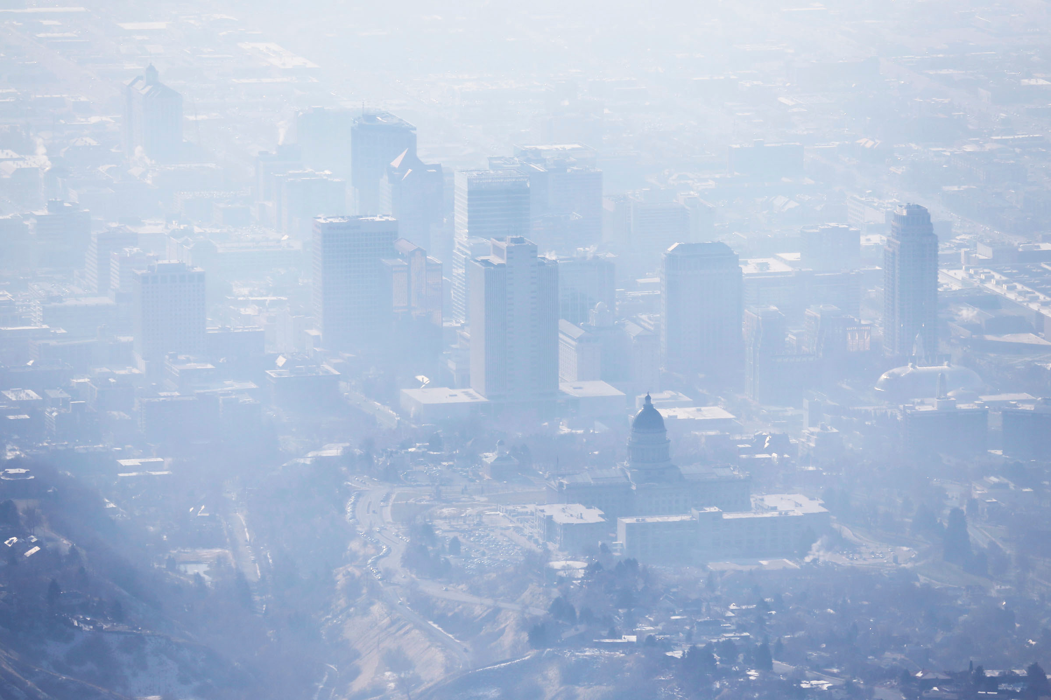

Slide 12
Control of Air pollution
Before releasing the gasses into atmosphere from various industries,
1. Separate the pollutants from harmless gasses.
2. Convert the pollutants in unharmful products.

Slide 13
Water pollution
1.Compounds of Hg, As, Pb
These are released by the industries as iron and steel industry.
Cause skin disease, and irreversible brain damage.

Slide 14
2.Inorganic Nitrates and Phosphates
These are released by the chemical plants and cause eutrophication
It is the condition of sudden increase of nutrients in lakes.
It affect fauna and flora.

Slide 15
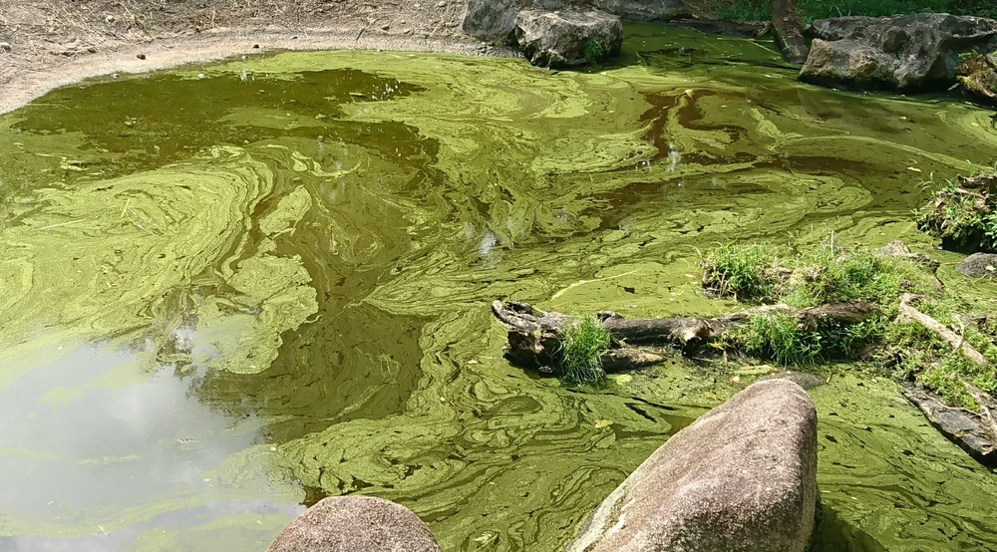
eutrophication

Slide 16
3.Organochlorins
These are released by the excess use of chemicals for agriculture.
They pass through food chains.
And Affect nervous system

Slide 17
4.Animal excreta
They are released with untreated sewage.
It contains pathogens and toxic wastes.
It causes epidemic diseases like cholera.

Slide 18
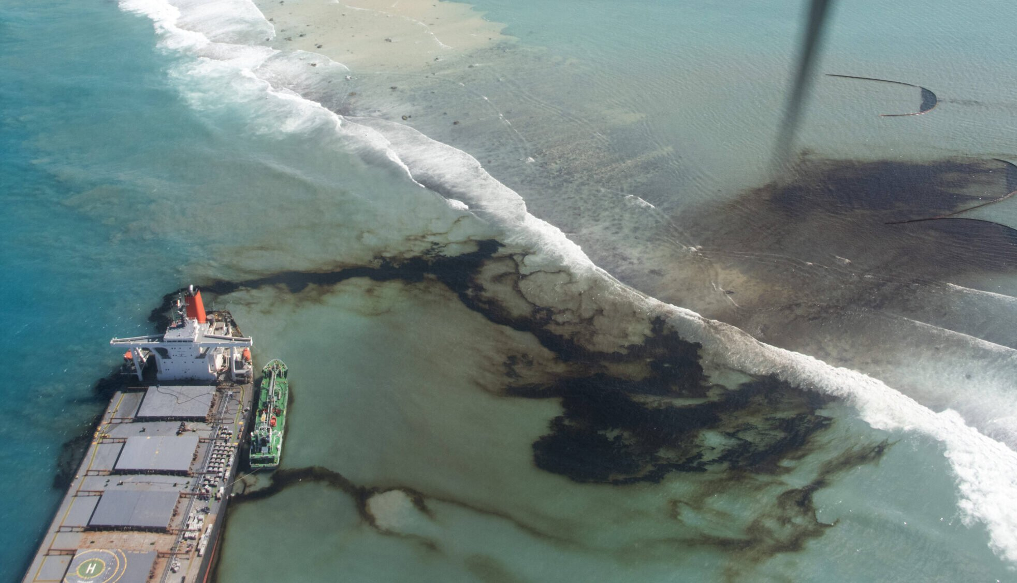
5.Oils in sea water
Are released by oil tankers when being loaded or unloaded.
It kills sea birds. Plants and animals in oceans.

Slide 19
6. Hot water
Is released by electric power plants
In lakes it causes sudden increase in temperature in the water body, affect fauna and flora.

Slide 20
Control of water pollution
1. Sewage and factory wastes should be treated before flow into water ways.
2. Various pollutants should be recycled instead of dumping in to water.

Slide 21
Thank you!

